Slide 1
ELEMENTS OF CIVIL ENGINEERING
WATER RESOURCE DEVELOPEMENT
Prepared By: (Group-3)
Vadlani Ronak
Patel Shivanshu
Patel Parth
Thaker Rajvi
Leuva Nisarg
Patel Rudra
ALPHA COLLEGE OF ENGINEERING & TECHNOLOGY, KHATRAJ

Slide 2
Introduction To Hydrology
Water is vital for all living organisms on Earth.
The name of the discipline is hydrology and is formed by two Greek words: "hydro" and “ology" meaning "water" and "science".
It is the science that deals with the occurrence, circulation and distribution of water of the earth and earth’s atmosphere on the earth, including that in atmosphere and below the surface of the earth.

Slide 3
Hydrologic Cycle
Except for the deep ground water, the total water supply of the earth is in constant circulation from earth to atmosphere, and back to the earth
The earth’s water circulatory system is known as the hydrologic cycle.
Precipitation = Run Off + Evaporation
(P) (R) (E)

Slide 4
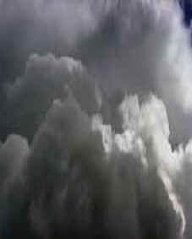
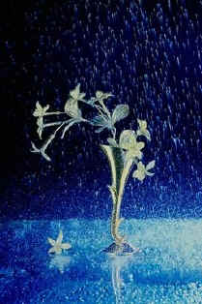
CONDENSATION
Water vapour in the air gets cold and changes back into liquid, forming clouds. This is called condensation.
PRECIPITATION
Precipitation occurs when so much water has condensed that the air cannot hold it anymore. Water falls to the earth in the form of rain, hail, sleet or snow.

Slide 5
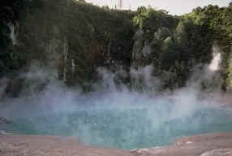
EVAPORATION
Evaporation is when the sun heats up water in rivers or lakes or the ocean and turns it into vapour or steam which rises in to the air.
TRANSPIRATION
Transpiration is the process by which plants lose water from their leaves. The water rises in to the air.

Slide 6
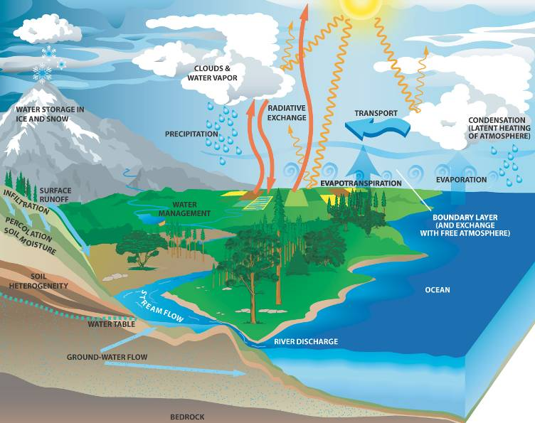
Evaporation from water bodies
Water vapour
moves upwards
Cloud formation
Condensation
Precipitate
Interception
Transpiration
Infiltration
Runoff–stream flow
Ground water flow

Slide 7
Application in Engineering
Hydrology finds its greatest application in the design and operation of water resources engineering projects.
Determining of the capacity of a reservoir from the rainfall records and the yearly discharge observation of a river.
Determination of the capacity peak flow of a river. (peak flood)
Determination of suitable site for hydroelectric power generation.
Methods to be adopted for the flood forecasting and flood control.
Sources of water supply in a town or city.
Availability of water for navigation.

Slide 8
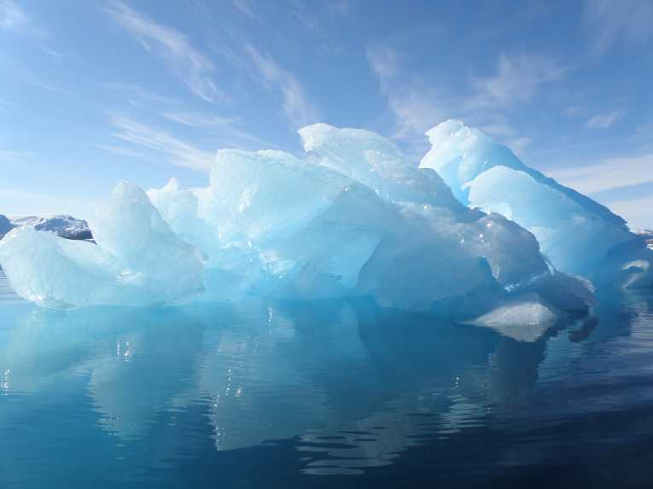
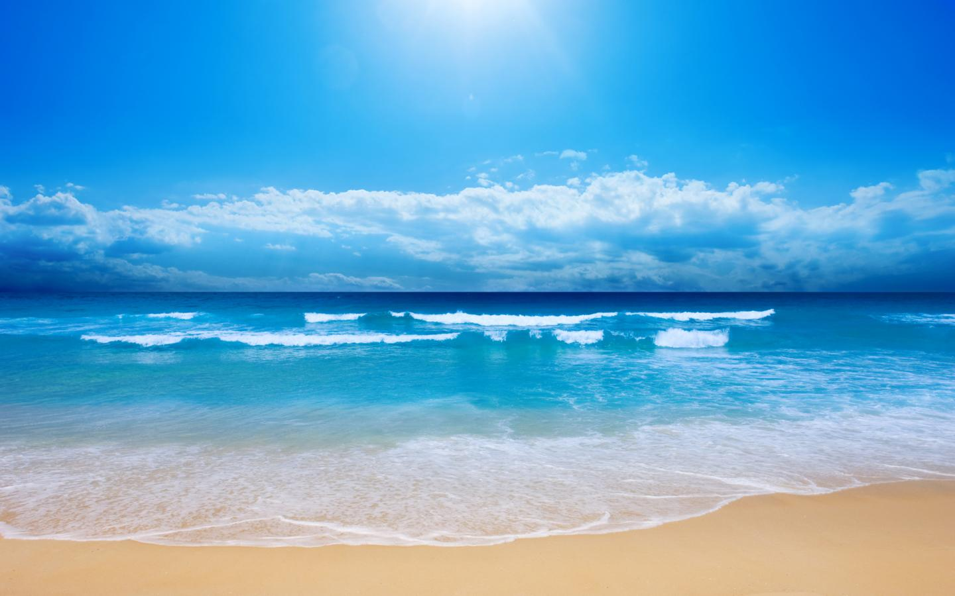
Sources Of Water
97% of the water on the Earth is salt water. However, only 3% percent is fresh water; slightly over 2/3 of this is frozen in glaciers and polar ice caps.

Slide 9
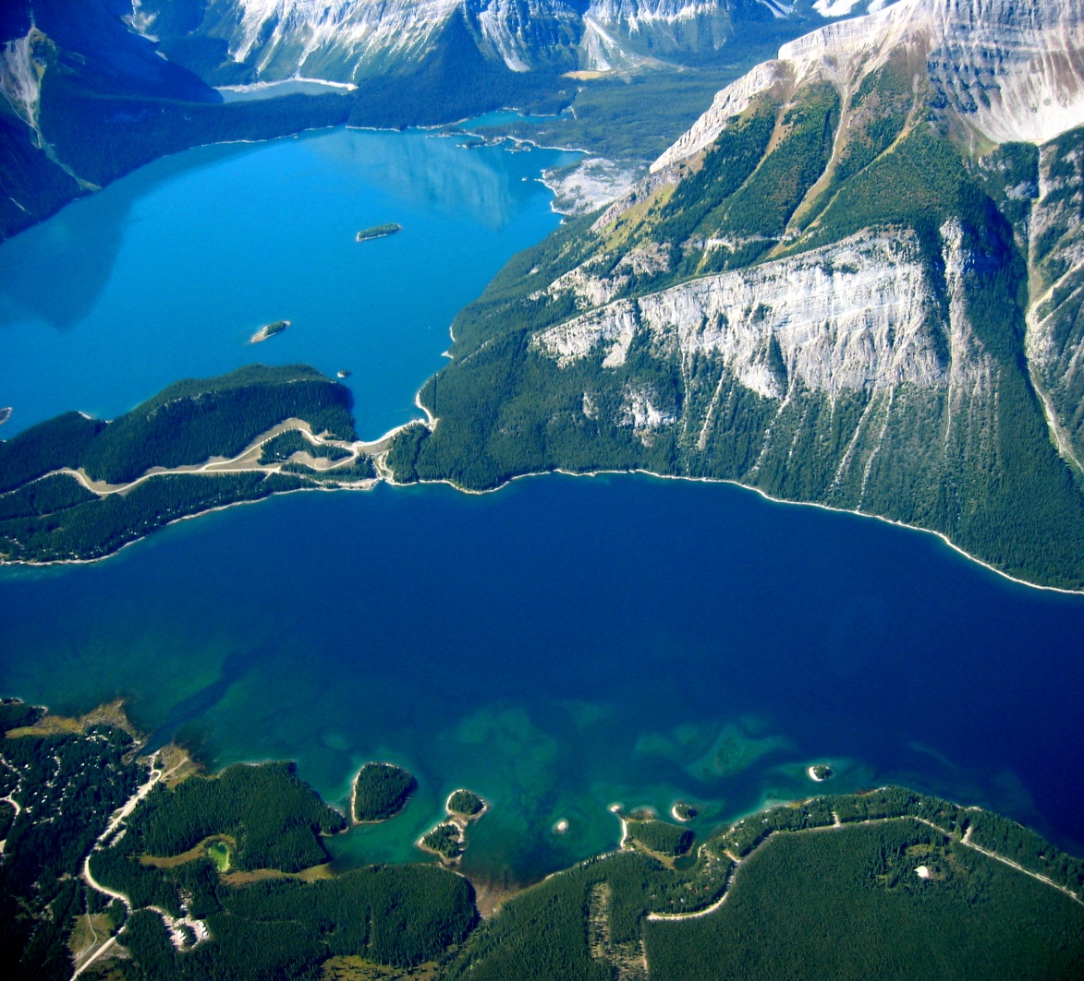
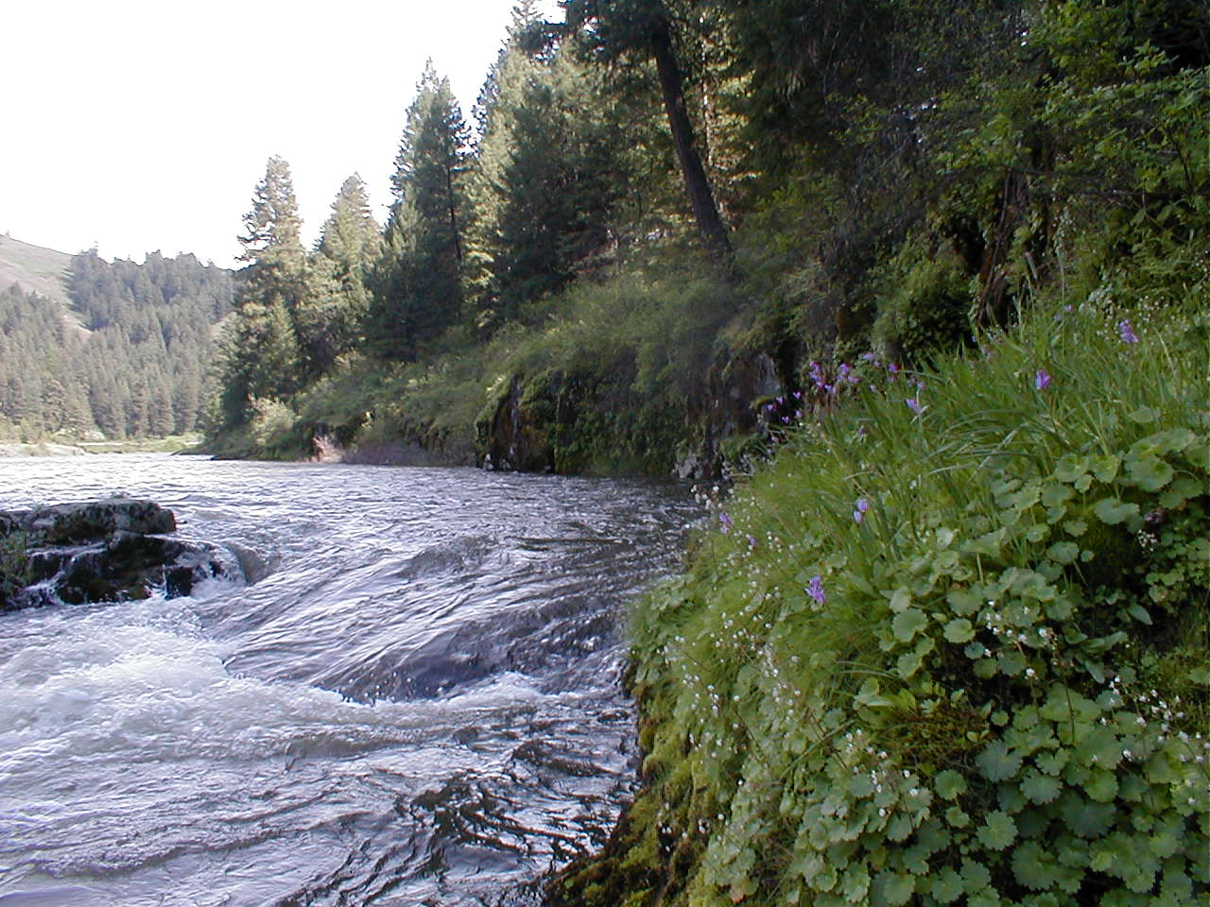
The remaining unfrozen freshwater is found mainly as groundwater, with only a small fraction present above ground or in the air.
Fresh water is a renewable resource

Slide 10
Distribution of Water
Source | % Total
Oceans | 96.5
Ice caps/glaciers | 1.74
Groundwater | 0.0089
Fresh | 0.76
Saline | 0.94
Soil Moisture | 0.001
Permafrost | 0.022
Lakes | 0.013
Fresh | 0.007
Saline | 0.006
Atmosphere | 0.001
Swamp Water | 0.0008
Rivers | 0.0002
Biological Water | 0.0001

Slide 11
Types Of Water Sources
Type | Location | Volume (l) | Percent
Surface | Lakes | 1.25 x 10¹⁷ | 0.009
 | Saline lakes/seas | 1.04 x 10¹⁷ | 0.008
 | Streams | 1.00 x 10¹⁵ | 0.0001
Subsurface | Vadose | 6.7 x 10¹⁶ | 0.005
 | Groundwater (to 750 m) | 4.17x 10¹⁸ | 0.31
 | Groundwater (below 750m) | 4.17x 10¹⁸ | 0.31
Other Reservoirs | Icecaps, glaciers | 2.9 x 10¹⁹ | 2.15
 | Atmosphere | 1.3 x 10¹⁶ | 0.001
 | Oceans | 1.32 x 10²¹ | 97.2

Slide 12
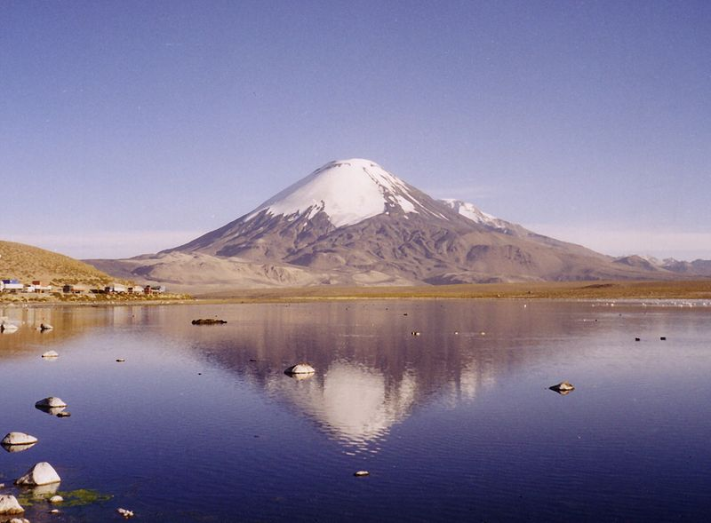
Surface water
Surface water is water in a river, lake or fresh water wetland. Surface water is naturally replenished by precipitation and naturally lost through discharge to the oceans and evaporation.

Slide 13
What is Ground Water ?
Found in the subsurface, inside pores within soil and rock
Spelled either as two words, Ground Water, or as one, Groundwater
Groundwater is the largest source of freshwater on earth, and was little used until recently.
With electricity and the modern pump, groundwater has become very important to agriculture, cities, and industries.
It is usually much cleaner than surface water.

Slide 15
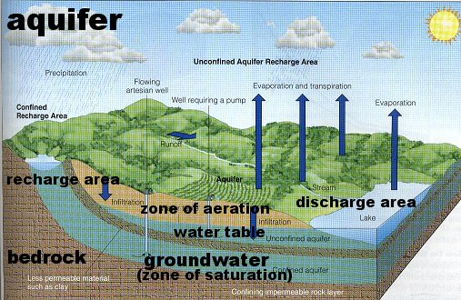
Aquifers
An aquifer is a body of highly permeable rock or regolith that can store water and yield sufficient quantities to supply wells.
Gravel and sand generally are good aquifers. Many sandstones and limestones are also good aquifers.

Slide 16
Aquifers are of two types:
Confined (bounded by confining beds).
Unconfined (an aquifer without overlain).
Unconfined aquifer: A partially filed aquifer exposed to the land surface and marked by a rising and falling water table
Confined aquifer (artesian aquifer): An aquifer completely filled with pressurized water and separated from the land surface by a relatively impermeable confining bed, such as shale

Slide 17
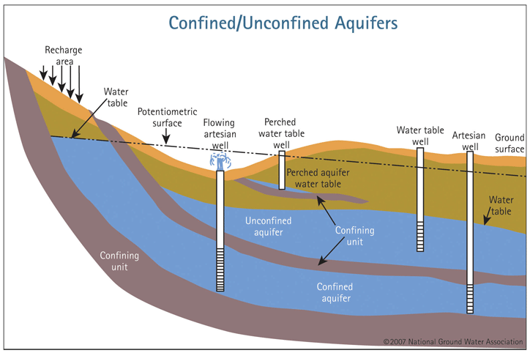

Slide 18
Wells
A water well is a hole or shaft, usually vertical, excavated in the earth for bringing groundwater to the surface. Water wells may be classified as:
Open wells or Dug wells
(2) Tube wells

Slide 19
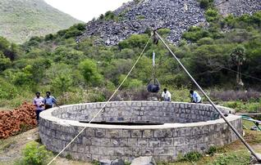
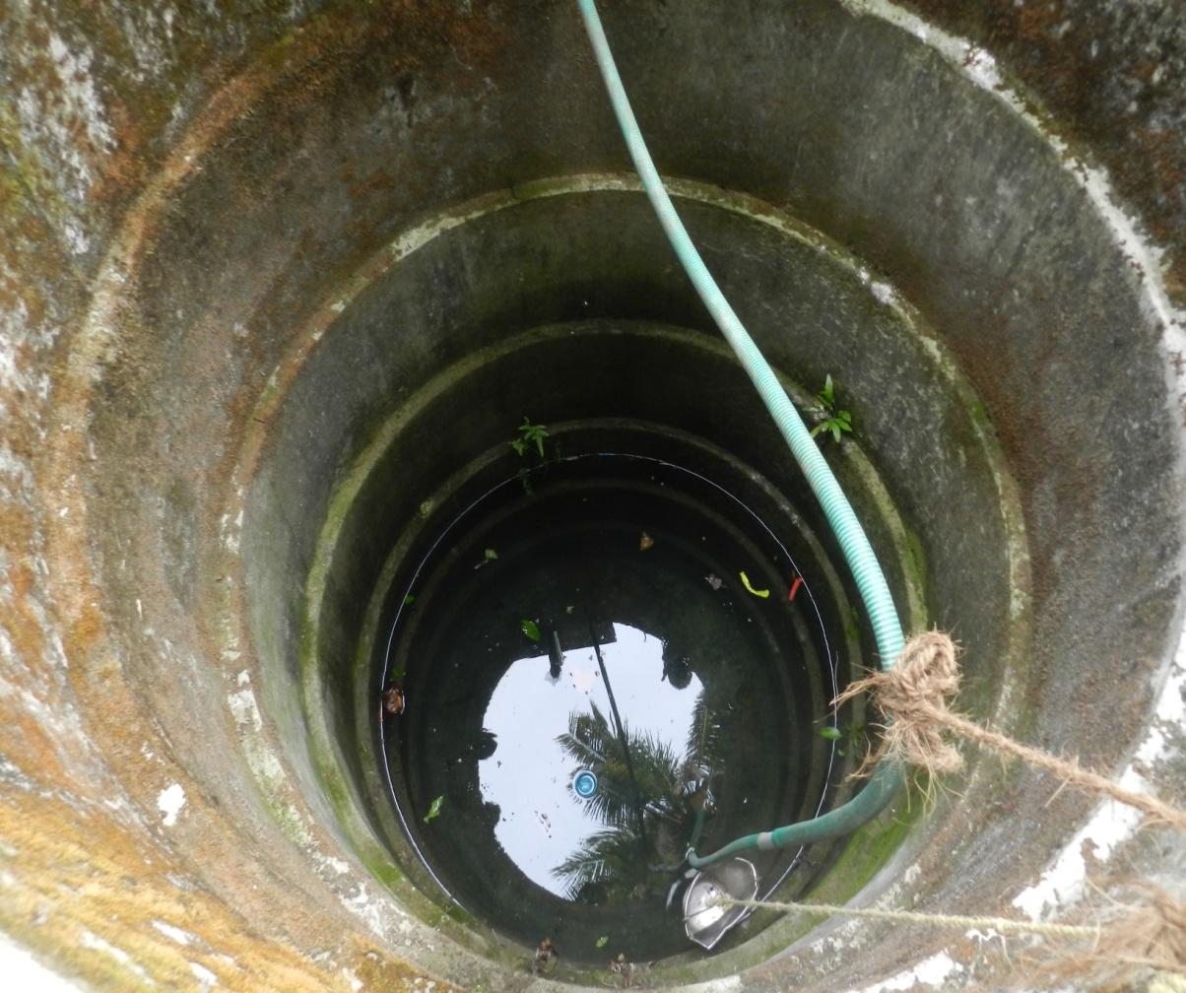
Open wells : Open wells are the wells which have comparatively large diameters but low yields (or discharges ) and are not very deep. The diameter of the open wells usually vary from 1m to
10m and yield is about 20m³ per hour or less.

Slide 20
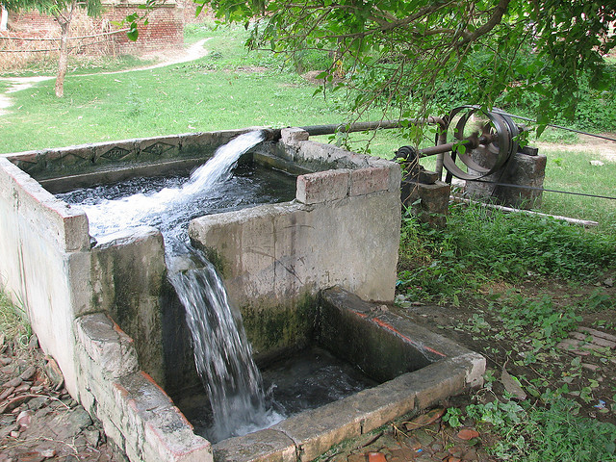
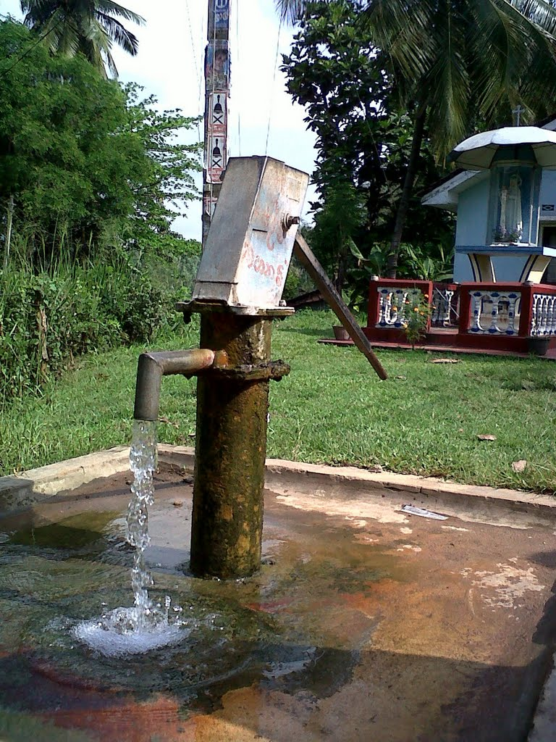
Tube wells : A tube well is a long pipe sunk into the ground intercepting one or more water bearing strata. Its diameter ranges from 80mm to 600mm.
The tube well may also be further classified as :
Shallow tube wells : depth about 30m and yield about 20m³ per hour.
Deep tube wells : Maximum depth about 600m, yield more than 800m³ per hour

Slide 21
THANK YOU

